Slide 1
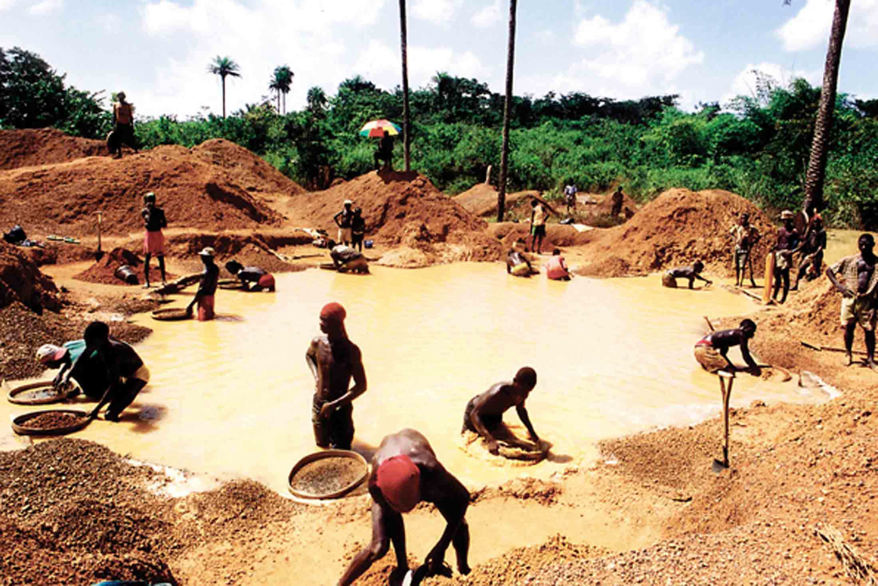
TRANSNATIONAL CRIMINALITY
MONEY LAUNDERING SCHEME (M.L.)

Slide 2

OMEGA DIAMONDS
ANTWERP
BELGIUM
GENEVE
SWISS
+40%
INVOICE
+40%
PROFIT BACK
START OFFSHORE
$
$
TULIP DIAMONDS
DUBAI
U.A.E
ORCHID
DUBAI
U.A.E
$
J.N.B
R.S.A
KICK BACK CASH
$
COST UNDER
$ O.P Injection
ASCORP
LUANDA
ANGOLA
MARNAUX
KINSHASHA
D.R.C

